Slide 1
Fuel depletion sequence - Mathematics & Implementation
Lorenzo Vergari
NE255

Slide 2
Outline
The depletion sequence
The Bateman equation
The MATREX algorithm
ORIGEN: Scale Tool for Depletion
Case Study

Slide 3
Burnup simulation in advanced reactors result on significantly expensive problems
Goal
Study the evolution of fuel composition under irradiation in reactor and its decay after discharge
But
Multi-Group cross sections are space and time dependent
Flux seen by pebbles dependent on surrounding pebbles
Detailed modeling of reactor and time-dependent transport simulations, coupled with burnup calculation
Unless…

Slide 4
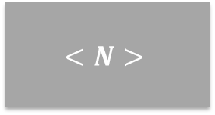
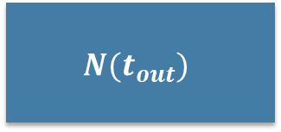
Computation of equilibrium one-group cross sections allows to decouple transport & burnup
$$<N>$$
Estimated Equilibrium Fuel Composition
CS
One-group cross sections
Cross-Sections averaged over equilibrium flux
Model of fuel cell
Representative of fuel/mod. ratio & burnup states
Time-independent TE
CS
0D Burnup calculation
$$N(t_{out})$$
Fuel composition at reactor discharge
Input
Computational step
Output

Slide 5
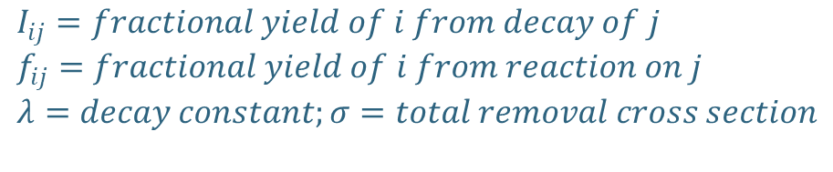
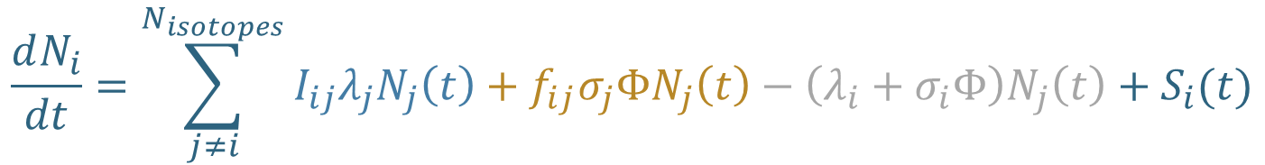

The Bateman equation describes the space-averaged evolution of fuel composition
Source from reaction
Source from decay
Loss term
$$\frac{dN_{i}}{dt}=\sum_{j≠i}^{N_{isotopes}}{I_{ij}λ_{j}N_{j}\left(t\right)+f_{ij}σ_{j}ΦN_{j}\left(t\right)−\left(λ_{i}+σ_{i}Φ\right)N_{j}\left(t\right)+S_{i}(t)}$$
$$A_{ij}N_{j}\left(t\right)$$
$$I_{ij}=fractional yield of i from decay of j$$
$$f_{ij}=fractional yield of i from reaction on j$$
$$λ=decay constant;σ=total removal cross section$$

Slide 6


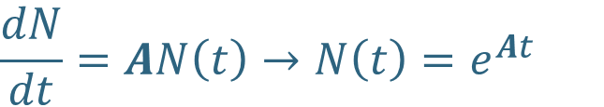


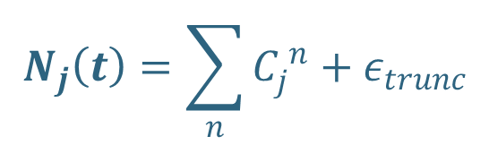

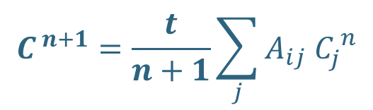
Algorithms for Bateman Equation - MATREX
$$\frac{dN}{dt}=AN\left(t\right)→N\left(t\right)=e^{At}$$
But A is a matrix!
Matrix Exponential*
$$N_{i}\left(t\right)=N_{i}\left(0\right)+t\sum_{j}{A_{ij}N_{j}(0)}+\frac{t}{2}\sum_{k}{\left[tA_{ik}\sum_{j}{A_{kj}N_{j}\left(0\right)}\right]+\frac{t}{3}\sum_{m}{\left[{\frac{t}{2}A}_{im}\sum_{k}{\left[{tA}_{mk}\sum_{j}{A_{kj}N_{j}\left(0\right)}\right]}\right]}}$$
$$C^{0}$$
$$C^{1}$$
$$C^{2}$$
$$C^{n+1}$$
$$C^{ n+1}=\frac{t}{n+1}\sum_{j}{A_{ij} C_{j}^{ n}}$$
$$N_{j}\left(t\right)=\sum_{n}{C_{j}^{ n}}+ε_{trunc}$$
$$C^{0}=N\left(0\right);$$
* CRAM is an alternative algorithm

Slide 7
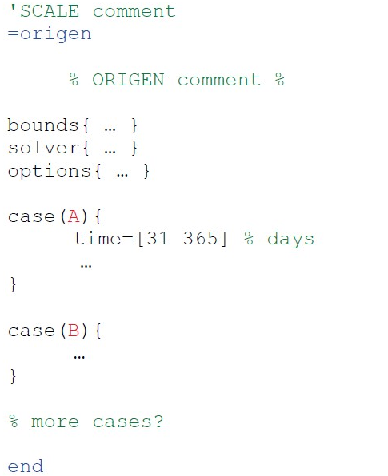
ORIGEN: SCALE module for depletion studies
Bounds for neutron and photon spectra
Inputs
CRAM or MATREX
Composition (entries or .f71 file)
Irradiation detail (time and power)
Cross sections (.f33 file)
Print, save and run options
Outputs
Composition (.f71 file)
Neutron and photon spectra (.f71 file)
OPUS plots
Case details for xs, compositions, time and power

Slide 8
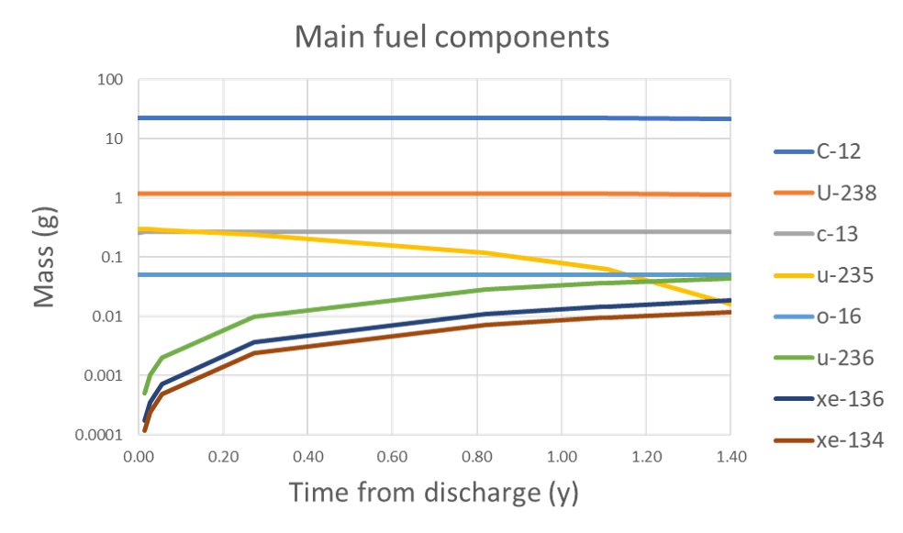
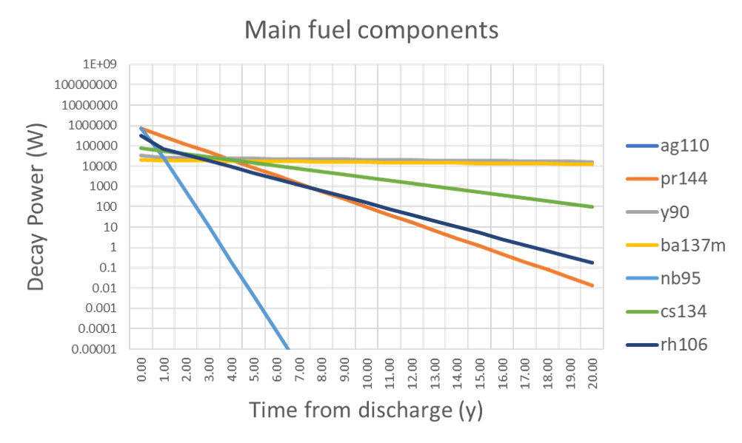

Case study and results
Step 1 – XS Generation
Step 2 – Irradiation
Step 3 – Decay
Cisneros, 2013
8 Burnup states
Equilibrium cell & reflecting BC
Production of FP & Activation
Consumption of 95% U-235
Simulation time= 51 s
P’’’@discharge=4.5 W/cm³
P’’’@1year=6.3 mW/cm³
Simulation time= 32 s
Step 4 – Criticality Safety
Spent pebbles stacked in FLiBe pool
k_{eff} = 0.35 by stacking all reactor pebbles
Critical mass is never reached (k_{eff} = 0.51 with 147M pebbles)

Slide 9
Summary
Coupled, time-dependent transport-depletion sequence is computationally expensive. Steady state calculation of equilibrium XS and 0D depletion has a lower cost
Fuel depletion described by the Bateman Equation. ORIGEN solves the Bateman equation with two algorithms (CRAM & MATREX)
A fuel depletion (irradiation + decay) sequence was simulated with the described algorithms. Similar outcomes obtained with CRAM and MATREX. CRAM required twice as much time as MATREX in the decay step.
Q&A

